Slide 1



ACE Tiverton
Student Leadership

Slide 2

Do you have something special to offer?
Do you believe that you can make an active, positive and valuable contribution to your School Community?

Slide 3
Student Leadership Roles:
Senior Student
Deputy Senior Students
Sports Leaders
School Wellbeing Leaders
Mental Health & LGBTQ+ leader
Student Council

Slide 4
Student Leadership - Responsibilities
Represent
ACE Tiverton School
Support
ACE Tiverton School Community
Promote
Ethos of Equality, Inclusion and Community

Slide 5
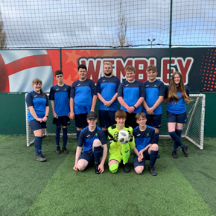
ACE Tiverton Senior Student
To represent ACE Tiverton School with professionalism, Commitment and Respect
To support and guide students in the ACE Tiverton School way and to achieving excellence.
To model outstanding behaviour, attendance, and attitude to learning
To represent ACE Tiverton School at Open Events, External events, and celebrations
To support the Student and Family Support Team with Assemblies
To support all Student Council Meetings
To promote the ethos of Equality, Inclusion and Community.
Meet with Candidates for Teaching Positions supported by SLT.
Take part in Student Panel during interview process supported by SLT.
Support with School Tours for prospective staff, parents, and visitors

Slide 6

ACE Tiverton Deputy Senior Student
To represent ACE Tiverton School with professionalism, Commitment and Respect
To support and guide students in the ACE Tiverton School way and to achieving excellence.
To model outstanding behaviour, attendance, and attitude to learning
To attend all student council meetings
To support younger students in the school community with kindness, respect and understanding
To promote the ethos of Equality, Inclusion and Community.
Support with School Tours for prospective staff, parents and visitors
Support in others leadership working with our Student Council, Sports Leader, and School Wellbeing Leaders

Slide 7

ACE Tiverton Student Leadership Roles:
Sports Leaders
Encourage young people and other sports leaders to develop and maintain integrity in their relationship with others.
School Wellbeing Leaders
To promote Mental Health and Well-being throughout the school.
Mental Health & LGBTQ+ leader
To work as a buddy/mentor to young people who have experienced mental health and well-being issues
Student Council
To represent ACE Tiverton school community. To model the ethos of Equality, Inclusion, Community, and mutual respect

Slide 8
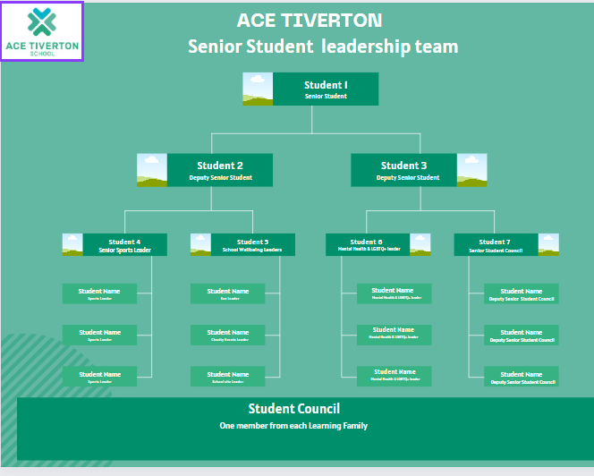
Student Leadership
Structure

Slide 9

The Application Process
The appointment process will vary dependent on the role and number of applications received. However, all students who apply for a post should be prepared to:
Collect an application form from Mrs. Fagg
Seek a short reference of recommendation from a Staff member at ACE Tiverton School.
Speak in front of peers to share views and gain support.
Be interviewed by Senior Staff
Be part of a group interview

Slide 10

Can you be a leader?

